Slide 1



SUB-FUND MEETING
FALL 2025
Who Gets to Know What?
Understanding the Law on Confidentiality
Presented by David Nash
FRIDAY, OCT. 3 | 10AM - 12PM

Slide 2


NJSIG EXECUTIVE DIRECTOR
Jill Deitch, Esq.
NJSIG
Executive Director

Slide 3
NJSIG CORE VALUES
1
2
3
MEMBER SERVICE & PARTNERSHIP
COMPREHENSIVE & DEPENDABLE COVERAGE
AFFORDABLE & STABLE RATES

Slide 4
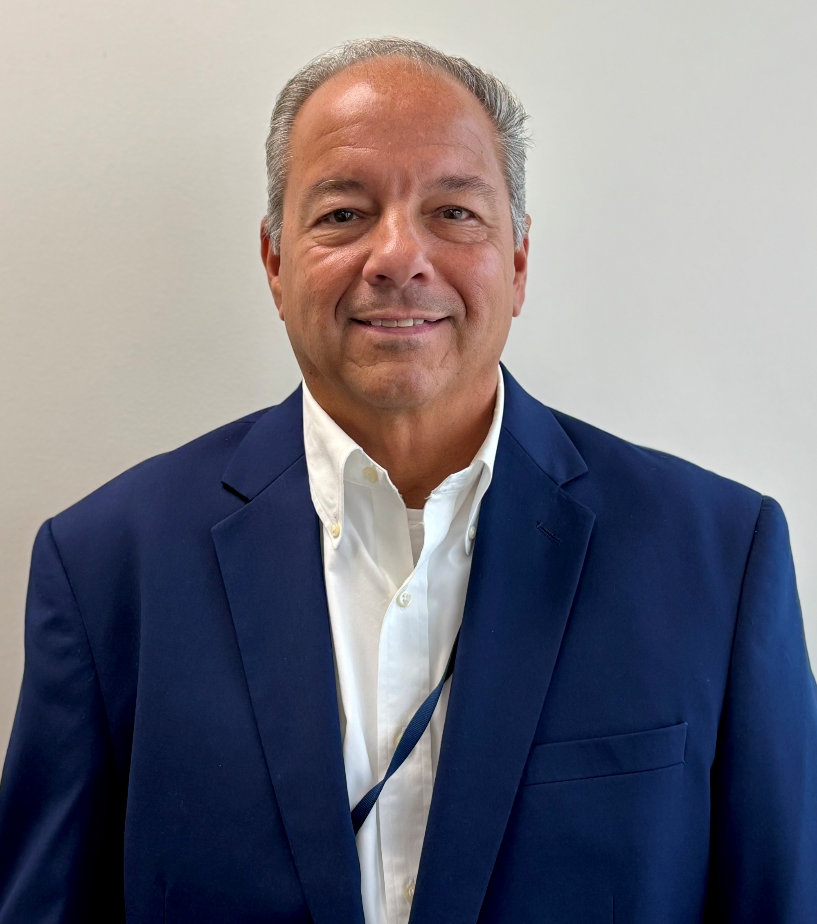
NJSIG VALUE ADDED SERVICES
Joseph Semptimphelter
NJSIG
Senior Business Development Specialist

Slide 5


MEMBER SERVICE & PARTNERSHIP
MEMBER-CENTRIC SERVICE:
Training and Education:
    Safety committees
    Online & in-house training
      Vector Solutions
    Defensive driving training
    Workers’ compensation training
  Inspections:
  Property: Every 5 years
  Playground: Annual (by request)
  NEW: Pre-QSAC Inspections!
  Valuation Services / Appraisals:
  Every 4 years via CBIZ

Slide 6

WORKERS’ COMPENSATION TOOLKIT
A practical guide outlining common coverage requirements and best practices to ensure proper use of your insurance program and reduce preventable risks.

Slide 7
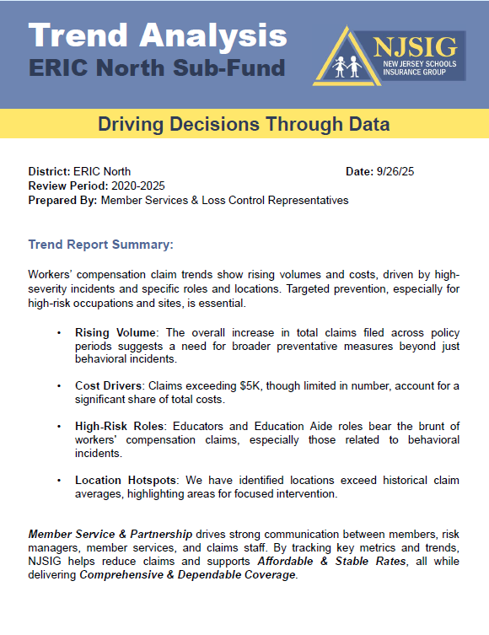
TREND ANALYSIS
ERIC South Sub-Fund
  Analyze trends and common loss sources
  Spot patterns in claims
  Identify opportunities to reduce risk
ERIC SOUTH

Slide 8
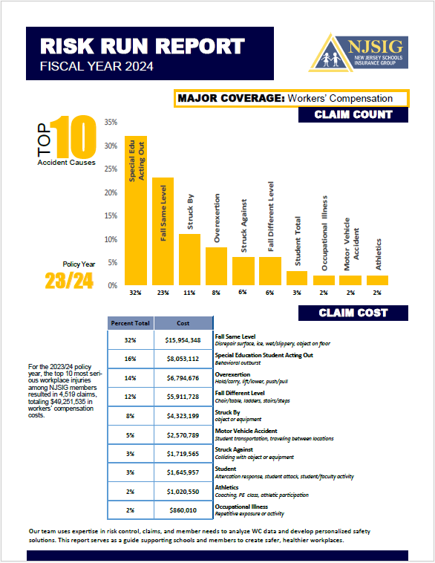
RISK RUN REPORT
  Summarizes key risks facing the organization or project
  Outlines potential impacts and current risk management
  Identifies actions needed to reduce or mitigate risks
  Helps stakeholders make informed decisions
  New Risk Runs will be provided in January 2026

Slide 9


Stay Informed with NJSIG Newsletters:
Get the latest on insurance, safety, and risk management
Expert tips and resources for NJ public school districts
Delivered straight to your inbox
www.NJSIG.org/newsletters

Slide 10
VALUE-ADDED SERVICES:
COMING SOON!
Activity Guide
Loss Control Library
  Practical tips for planning non-routine activities
  Ensures proper insurance use and risk reduction
  Downloadable safety tools: guides, checklists, templates
  Supports your district’s risk management efforts

Slide 11

NJSIG @ NJSBA WORKSHOP
NJSIG Presentations
Ethics in the School Board Trenches 1 QPA credit – Ethics .5 credit – Board Member Academy Tuesday, October 21, 2025 10:30-11:30 AM and 2:30-3:30 PM Presenters: Sherwin Archibald NJSIG Claims Manager Rita Barone, Esq. Partner at Flanagan, Barone & O’Brien LLC | Building Effective Return-to-Work Programs .25 credit: Board Member Academy Tuesday, October 21, 2025 – 1:00-1:45 PM Wednesday, October 22, 2025 – 1:00-1:45 PM Presenters: Jill Deitch Esq, NJSIG Executive Director Joanna Radomicki NJSIG Member Services and Loss Control Representative
Visit NJSIG at Booth #740

Slide 12

Law, Ethics and Governance for All Leaders, including an Overview of New and Emerging Issues
Who Gets to Know What?
Understanding the Law on Confidentiality
and Information Sharing

Slide 13
Presenters
David Nash, Esq., Director of Legal Education and National Outreach
Rebecca Gold, LEGAL ONE Consultant

Slide 14
DISCLAIMER
This presentation is intended as a summary of law only and is not meant as legal advice. Please consult your attorney to obtain legal advice.
Participants are authorized to use the LEGAL ONE materials provided in this training to offer turnkey training within the respective participant's school district or place of employment, provided that participants provide proper credit to LEGAL ONE for having developed said materials and further provided that such turnkey training is offered at no charge.

Slide 15
Key Topics
Overview of Relevant Laws on Confidentiality and Information Sharing
FERPA, HIPAA and Other Student Privacy Protections
OPRA 2.0 – Understanding the Revised Open Public Records Act
Open Public Meetings Act
IDEA and Section 504
Working with Law Enforcement
Employee Privacy and the Board of Education

Slide 16
scenarios

Slide 17
Scenario 1 Student with Disability
You have a contracted bus driver. Does the driver have a need to know about students on the bus who may require administration of emergency meds? Or that require other accommodations on the bus?
Can an outside contractor be provided information about what is in an IEP or 504 plan? If so, when?
You have a Substitute Teacher subbing in a classroom with Classified Students. Is the Substitute Teacher supposed to be informed about what is in a student’s IEP and/or 504 Plan?
A student has diabetes but the parents thinks he can manage his own care and don’t want any school staff to know about his condition. What do you do?

Slide 18
Scenario 2 – OPRA 2.0
Mr. Nudge is a regular attendee at school board meetings. Each month, he gets up, vents about an issue where he says the district is “burying the truth.” This month, he claims that the district’s legal fees are out of control. He demands to know how much the board attorney is paid per hour, what cases he is working on, who he is meeting with from the district, and demanded to see all settlement agreements reached between the district and other parties over the past year.

Slide 19
Scenario 3 – BOE Public Comments
For the first time in 20 years, the Superior High School football team has not made the state playoffs, after losing their final 3 games. It is also the first year that the new head football coach, Mr. Upbeat, has been on the job.
At a board meeting following the last football game, several community members get up to speak, and call for the firing of both Mr. Upbeat AND the district’s Athletic Director, Ms. Caring.
After the 8th speaker on the subject, the Board President says “Look. I understand how you all feel. I am frustrated too. Hey, we always assess coaches every year, and believe me we are going to look very closely after this year’s epic collapse in the last 3 games. But as for the A.D., we should slow down before calling to end someone’s career. The public doesn’t know everything Ms. Caring has been going through over the past year.. Believe me, she has had some challenges. I wish I could say more, but I can’t.”
What legal issues are raised? How should this be addressed?

Slide 20
Overview of relevant laws

Slide 21
Key Laws Addressing Confidentiality and Information Sharing
FERPA
New Jersey Pupil Records
HIPAA
42 CFR Part 2
Code of Ethics for School Board Members
Open Public Records Act
Open Public Meetings Act
Rice Notice
Weingarten Rights
Tenure Hearing Law
Anti-Bullying Bill of Rights/Student Discipline Hearings

Slide 22
Best Practice Consideration
Annual Training
Annual Confidentiality Agreement for All Staff
Given the importance of ensuring that all staff and contracted service providers understand and abide by confidentiality requirements, annual training and the signing of an annual agreement to abide by all confidentiality laws may reduce potential for violations
May also wish to consider stand alone confidentiality agreements in certain situations (e.g., for those on interview committees)

Slide 23
Student privacy protections

Slide 24
Key Laws
Student Confidentiality Protections
  NJ Student Records Law
  FERPA
  HIPAA
  42 CFR Part 2
  HIB, Other Student Discipline Hearings
  New Jersey Law Against Discrimination
  Title IX
  IDEA/Section 504

Slide 25
NJ Student Records Law
Under New Jersey law, “Student Record” means any information related to an individual student gathered within or outside the school district and maintained within the school district, regardless of the physical form in which it is maintained. Essential in this definition is the idea that any information that is maintained for the purpose of second party review is considered a student record.
Therefore, information recorded by any certified school personnel solely as a memory aid, not for the use of a second party, is excluded from this definition. See N.J.A.C. 6A:32-2.1.
Note that even electronic communications with personal devices can create student records. For example, two staff members messaging each other about a student’s academic struggles or behavior issues would be considered a student record.

Slide 26
Disclosure of Discipline Records
Student discipline records must be transferred from a NJ public school district to new a district (public or private). Note that Private school does not have to transfer information to a public school. Written notice to parents, BUT NOT CONSENT, is required, so parent is aware that discipline records are being sent. See N.J.S.A. 18A:36-19a and 18A:36-25.1.
Common problems
  discipline records not being transferred with student
  Lack of notice to parents that records will be disclosed

Slide 27
Information Sharing
Regarding Diabetes
Parent has a child with diabetes and parent does not want the school district staff to receive any information, and wants the child to directly manage their own care
  What Now???
  See N.J.S.A. 18A:40-12.18 Release for sharing of certain medical information.
  The school nurse shall obtain a release from the parent or guardian of a diabetic student to authorize the sharing of medical information between the student's physician or advanced practice nurse and other health care providers. The release shall also authorize the school nurse to share medical information with other staff members of the school district as necessary.
See NJDOE Guidelines for Care of Student with Diabetes

Slide 28
FERPA
FERPA recognizes three types of student records that have various levels of protection – education records, personally identifiable information, and directory information.
FERPA defines “education records” as “records, files, documents, and other materials” that are “maintained by an educational agency or institution, or by a person acting for such agency or institution.”
“Personally identifiable information” is a FERPA term referring to identifiable information that is maintained in education records and includes direct identifiers, such as a student’s name or identification number, indirect identifiers, such as a student’s date of birth, or other information which can be used to distinguish or trace an individual’s identity either directly or indirectly through linkages with other information. FERPA includes strong protections for personally identifiable information of students, except for directory information which includes a lesser level of protection.

Slide 29
FERPA
Directory information is a subset of personally identifiable information and is defined as “information contained in an education record of a student that would not generally be considered harmful or an invasion of privacy if disclosed.” This includes such items as a list of students’ names, addresses, and telephone numbers, and also includes a student ID number (including electronic identifiers) provided it cannot be used to gain access to education records.
Directory information, however, does not include a student’s Social Security number nor can the Social Security number be used to confirm directory information.
Under FERPA, school districts must provide annual notice to parents of their right to opt out of the sharing of directory information if they so choose, along with notice of other rights available to parents under FERPA.

Slide 30
“Accidental” Student Records
Electronic communications between two or more school officials regarding a specific student will likely create a student record
This may include informal text messages and could include information that school administrators are not aware of
Irrelevant if communication involved use of personal devices, rather than district devices
Case law has required that parents be provided access to derogatory electronic communications between staff members

Slide 31
What if the District Doesn’t Know?
Requirements that all communication between SD personnel and students/parents be done on the school server/using the school email system are not always followed
  Teachers / staff are communicating via personal texts and/or emails
  When legal proceeding occurs (Due Process Hearing, etc.), SD is obligated to turn over all of the students’ records.
  Since staff has communicated with parents/students via personal texts / off of the school server, the SD is not aware of these communications and fails to produce them
  Parents know they exist and demand them
    Teacher / staff member must now turn over personal cell phone / account information
    SD may be subject to sanctions for failing to produce required records
    SD is blind sided – it might have done something differently if it had seen these communications
    Teacher / staff member may be subject to disciplinary action for failing to follow SD directives re: communications

Slide 32
FERPA Resources
Annual FERPA and PPRA Notices: Annual Notices | Protecting Student Privacy
Parent Guide to FERPA – A Parent Guide to the Family Educational Rights and Privacy Act (FERPA)
FAQs on FERPA – Frequently Asked Questions | Protecting Student Privacy
FAQ on photos and videos under FERPA – FAQs on Photos and Videos under FERPA | Protecting Student Privacy

Slide 33
Gender Identity/Sexual Orientation
See NJDOE Guidance 2018
Honor what student is saying
Where possible, maintain confidentiality of information shared and honor request not to disclose to parent
State AG – suing school districts that adopted policies that would have prompted parent notice against student wishes – preliminary injunction against implementing policies
NOTE that IF written records exist in district (not just memory aids) and parent requests to see student records, must make available to parent

Slide 34
Immigration Status
No right for schools to request information regarding immigration status
No need to maintain such information if it is provided by student or parent/guardian
Would be violation of FERPA and NJ law to disclose information learned as a school employee regarding immigration status without authorization to do so
Be careful that school district is not requiring information during registration process that would inadvertently disclose citizenship status
See NJDOE Guidance on School Related State and Federal Requirements related to Immigration

Slide 35
Parameters of FERPA,
Information Sharing
See LEGAL ONE article – Understanding FERPA and How to Navigate Shifting Federal Priorities
  Addresses gender identity and ICE questions
No proactive obligation to notify parent whenever information is added to student record
HOWEVER, must provide access to student record within 10 days of request under NJ law (FERPA allows 45 days, but only 10 under NJ law)

Slide 36
Transportation for Students with Disabilities
NJDOE February 12, 2025 Broadcast Memo
  Transportation Considerations for Students with Disabilities
Provides practical information, discussion prompts, and best practices to support collaborative planning and ensure transportation arrangements meet the unique needs of students with disabilities
NJDOE January 29 2025 Broadcast Memo
  Student Information Card for Transportation of Students with Disabilities and Information Sharing with Bus Drive and Bus Aide

Slide 37
Mandated Records
Mandated Records - N.J.A.C. 6A:32-7.2:
  Student name, address, telephone number, date of birth, name of parent(s), gender, citizenship
  Standardized assessment and test answer sheets (protocol), grades, attendance, classes attended, grade level completed, year completed
  Record of daily attendance
  Descriptions of student progress according to the system of student evaluation used in the district
  History and status of physical health including results of physical exams given by qualified school district employees
  Records required for students with disabilities
  Federal law now requires maintenance of information on suspensions and expulsions
  Records must be kept for 100 years
  Other records required by law/board policy

Slide 38
Access to Student Records
For a detailed description of who has access to student records and the conditions required, see A Parent Guide to the Family Educational Rights and Privacy Act (FERPA) and N.J.A.C. 6A:32-7.5.
That access must be provided within 45 days of the request (but under NJ law the timeline is 10 days). A school official is required to be present as the parent or guardian is reviewing the student record. Upon request, copies of records must also be provided, and the district may charge reasonable fees.

Slide 39
Access to Student Records
Parents of a dependent student;
School officials with a legitimate educational interest;
The school/school district where the student seeks or intends to enroll;
To those requesting Directory Information provided the parent has been provided notice of their rights to opt out of sharing such information and has not opted out;
To authorized representatives of, among others, State and local educational authorities, such as a State department of education, in connection with an audit or evaluation of Federal- or State-supported education programs, or for the enforcement of or compliance with Federal legal requirements that relate to those programs;
To a representative of a State or local child welfare agency or Tribal organization
regarding a child in foster care;
To State and local officials or authorities pursuant to a State statute concerning the juvenile justice system and the system’s ability to effectively serve the student whose records are being disclosed;
To organizations conducting studies for, or on behalf of, the school for specified purposes including improving instruction;
To comply with a judicial order or a lawfully issued subpoena; and
In connection with a health or safety emergency.

Slide 40
One Parent’s Access to
Another Child’s Records
Video Footage - if the school has video footage that is relevant to a student disciplinary matter a parent would have the right to view the video even if other students are recognizable in the video. See In Re Wachter, in which a Pennsylvania school district was advised by the U.S. Department of Education Office of the Chief Privacy Officer that a parent had a right to inspect video footage showing her son’s role in a hazing incident, even though the parents of other students did not consent to disclosure of their child’s images in the video.
Info on Harassment - See also Letter to Anonymous, August 2017 regarding limited information sharing about the offending student when a student is the victim of harassment based on a protected class under federal law.
New Jersey Admin Code - New Jersey law also specifically recognizes that some situations may arise where the parent of one child is entitled to see information about another child. See N.J.A.C. 6A:32-7.1(f), which provides that “[t]he parent or adult student shall have access to his or her own records and have access to or be specifically informed about only that portion of another student’s record that contains information about his or her child or himself or herself.”

Slide 41
FERPA and HIPAA
See Joint Guidance on Application of FERPA and HIPAA
Generally schools are not governed by HIPAA
Where the HIPAA Privacy Rule applies, does it allow a health care provider to disclose protected health information (PHI) about a student to a school nurse or physician?
Yes. The HIPAA Privacy Rule allows covered health care providers to disclose PHI about students to school nurses, physicians, or other health care providers for treatment purposes, without the authorization of the student or student’s parent. For example, a student’s primary care physician may discuss the student’s medication and other health care needs with a school nurse who will administer the student’s medication and provide care to the student while the student is at school.

Slide 42
Permissible Disclosure to Protect Health and Safety
FERPA permits disclosure of personally identifiable information in connection with an emergency if knowledge of the information is necessary to protect the health or safety of the student or other individuals.
What constitutes an “emergency”?
  Based on the “totality of the circumstances” is there “an articulable and significant threat to the health or safety of a student or other individuals”?
School officials are given the benefit of the doubt!
  “If, based on the information available at the time of the determination, there is a rational basis for the determination, the Department will not substitute its judgment for that of the educational agency or institution in evaluating the circumstances and making its determination.” See 34 CFR 99.36.

Slide 43
42 CFR Part 2 Exceptions
Covers participation in school district comprehensive drug and alcohol program
Substance Use disorder treatment programs that receive federal funding
All information concerning a student’s involvement in a school intervention or treatment program for alcohol or other drug abuse shall be kept strictly confidential, according to the requirements of 42 CFR Part 2, N.J.S.A. 18A:40A-7.1 and 7.2 and N.J.A.C. 6A:16-3.2.
Public Schools are covered entities under 42 CFR Part 2
There are a few limited exceptions when providers can make disclosures without a patient’s written consent, including:
Internal communications
Medical emergencies
Reports of alleged child abuse or neglect (if required by state law)
Reports of a crime on program premises or against program personnel
Qualified audits or evaluations of the program
Research
Qualified service organization agreement
Pursuant to a Part 2-specific court order

Slide 44
HIB Information
P.L. 2021, c. 338
Confirmed HIB incident is placed in file of student aggressor
IF educationally relevant, should also be placed in file of victim (e.g., L.W. v. Toms River)
Redacted copy of the form that removes all student identification information shall be confidentially shared with the BOE after the conclusion of the investigation, if a hearing before the BOE is requested by a parent or guardian.
  Clarifies that Incident Report Form must be shared with BOE if hearing is requested AND must be redacted

Slide 45
Key Differences HIB v. Title IX
Different role for Title IX Coordinator, Decisionmaker, Investigator
  Title IX Decisionmaker cannot be the same person as the Investigator. Could be one person or a panel
  Title IX Coordinator could be Investigator, but not Decisionmaker
Only parent, student or Title IX Coordinator can file Title IX complaint
Broader Rights than under HIB to have a parent/rep
The Title IX Notice requirement is broader that the requirement under HIB - Need to provide sufficient detail PRIOR TO first interview to prepare a response
Title IX investigation must be reasonably prompt, HIB must be within 10 school days
Need to complete Title IX grievance process before imposing discipline (Emergency Process for Removal Still Exists)
Must provide notice of the additional allegations learned during investigation to the parties whose identities are known
Right to request specific questions be asked unlike with HIB
Informal Resolution NOT an option for HIB, but is for Title IX if all parties consent

Slide 46
Opra 2.0 understanding the revised Open public records act

Slide 47
Purpose of OPRA
Make government records readily accessible for public inspection, copying, examination
Limited exceptions as outlined in law, but such exceptions are “construed in favor of public access”
Duty to safeguard citizens’ personal information if release would violate a reasonable expectation of privacy

Slide 48
What is a Public Record?
"Government record" or "record" means:
  any paper, written or printed book, document, drawing, map, plan, photograph, microfilm, data processed or image processed document, information stored or maintained electronically or by sound-recording or in a similar device, or any copy thereof,
    THAT MEANS YOUR TEXT MESSAGES CAN BE PUBLIC RECORDS!
    EVEN ON YOUR PERSONAL DEVICE!
  that has been made, maintained or kept on file in the course of his or its official business by any officer, commission, agency or authority of the State or of any political subdivision thereof, including subordinate boards thereof,
  or that has been received in the course of his or its official business by any such officer, commission, agency, or authority of the State or of any political subdivision thereof, including subordinate boards thereof.
  The terms shall not include inter-agency or intra-agency advisory, consultative, or deliberative material.

Slide 49
Exceptions
Student Records (Access governed by FERPA)
Public Employee information:
  related to sexual harassment complaints, grievances, collective bargaining positions/strategies
  broader Personal Identifying Information
Advisory, Consultative or Deliberative
Attorney-Client Privilege
Computer/Building Security and Techniques
Advantage to Bidders
Risk Management
Court Orders

Slide 50
OPRA Expanded Privacy Protection
P.L. 2024, c. 16. 6/5/24, effective 9/3/24. Open Public Records Act Amendments
Open Public Records Act Amendments (continued)
Increased privacy by specifically exempting disclosure of:
  Debit card number, Bank account information,
  Month & day of birth,
  Any personal email address required as part of government application, service, or programs, any personal telephone number.
  Portion of any document that discloses the personal identifying information of any person provided to a public agency for the sole purpose of receiving official notifications or those on special assistance list.
  Any portion of document that would disclose information for those under the age 18.
  Any indecent or graphic image of person's intimate parts that are captured in a photo or video recording without prior written consent of the subject of the photo or video.

Slide 51
OPRA Security Exemptions
Other exemptions from OPRA
  Security alarm system activity & access reports, including video footage, for any public building, facility or grounds.
  Unless the requester identifies a specific incident that occured or a specific date & limited time period & is deemed not to compromise the integrity of the security system by revealing capabilities & vulnerabilities of the system.

Slide 52
OPRA Website Redirect Option
Fulfilling Requests
  Can direct a requestor to information on public agency's website to fulfill OPRA request--Cannot charge a fee.
  To extent feasible must make records available on website. Can enter into a shared services agreement for this requirement.
  Website must include a search bar on its homepage.
  If record is unabridged & complete, then the OPRA request can be fulfilled by providing a link to requested document
  Unless the document on the website fails to contain non-protected information, then custodian must provide the original version with appropriate redactions
  If upon request, the custodian must make a reasonable attempt to assist within 7 business days of assistance request. If requestor is still unable to find the document, the custodian must provide a physical copy at a fee within 7 business days.

Slide 53
Limited Duty to Manipulate Data
If the public agency does not maintain the record in the electronic medium or format requested, and the medium or format is not available to the public agency without a substantial amount of manipulation or programming of information technology, the custodian shall be under no obligation to convert the record to the electronic medium or format requested but shall, at a minimum, provide a copy in the electronic format maintained by the public agency
If can be done, may charge additional reasonable fees for manipulation and/or collation of data

Slide 54
OPRA Relief for Abuses
Relief for Abuses
  Avenue to address request filed with intent to substantially impair the performance of government functions.
  Court can:
  Issue protective order limiting number & scope of request.
  Refer matter to mediation.
  Waive the required response time.
  Limit or eliminate public agency's duty to respond to request.
  Issue a protective order if it finds by clear and convincing evidence

Slide 55
Open public meetings act

Slide 56
Sen. Byron M. Baer Open Public Meetings Act (“Sunshine Law”)
Exceptions to OPMA Requirements
Advisory bodies with no effective authority.
Committees with less than quorum with no authority to act.
Three (3) or more public bodies at a convention or similar type gathering.
Chance encounters, social gatherings.

Slide 57
Sen. Byron M. Baer Open Public Meetings Act (“Sunshine Law”)
Meeting Notice - N.J.S.A. 10:4-8,9
Regular – Time, Date, Location, Annually, 7 days reorganization
Special – 48 hour advance notice of meeting, including time, date, location and agenda to the extent known, whether formal action will be taken
Emergency – Unforeseen, substantial harm to public interest, ¾ vote of members present
Provide Sample Meeting Notices

Slide 58
Sen. Byron M. Baer Open Public Meetings Act (“Sunshine Law”)
Closed Session Topics
N.J.S.A. 10:4-12
Matters confidential by law
Matters which could impair right to receive federal funds
Matters of individual privacy
Collective bargaining
Lease/purchase of property, bank rates, if public interest could be adversely affected

Slide 59
Sen. Byron M. Baer Open Public Meetings Act (“Sunshine Law”)
Closed Session Topics
N.J.S.A. 10:4-12
Tactics and techniques for protecting safety and property of the public
Contract negotiation other than collective bargaining
Pending/anticipated litigation; attorney – client privilege
Deliberations of public body after a public hearing

Slide 60
Sen. Byron M. Baer Open Public Meetings Act (“Sunshine Law”)
Closed Session Topics
N.J.S.A. 10:4-12 (b) (8)
Personnel Exception – Rice Notice
Any matter involving the employment, appointment, termination of employment, terms and conditions of employment, evaluation of the performance of, promotion, or disciplining of any specific prospective public officer or employee or current public officer or employee employed or appointed by the public body, unless all the individual employees or appointees whose rights could be adversely affected request in writing that the matter or matters be discussed at a public meeting;

Slide 61
Sen. Byron M. Baer Open Public Meetings Act (“Sunshine Law”)
Closed Session Topics
N.J.S.A. 10:4-12 (b) (8)
Personnel Exception – Rice Notice
48 Hours in advance of meeting
Right to request that closed session discussion be moved to public session
No right to attend closed session; if invited by the board, right to bring representation
Regina Rice v. Union County Regional Board of Education, 1977 AD
Provide sample Rice notices

Slide 62
Sen. Byron M. Baer Open Public Meetings Act (“Sunshine Law”)
Closed Session Resolution
N.J.S.A. 10:4-13
Prior to entering closed session, the board must adopt a resolution indicating the general nature of the subject, the time and circumstances under which the discussion can be disclosed to the public.
Simply reiterating the exceptions is not enough; must be some specificity.
See Trenton State Bd. of Trustees, McGovern v. Rutgers, New Jersey Foundation for Local Government v. Island Heights

Slide 63
Working with law enforcement

Slide 64
MOA with Law Enforcement
NJDOE 12/13/23 Release of the 2023-2024 Memorandum of Agreement Between Education and Law Enforcement Officials
Outlines parameters for information sharing between schools and law enforcement
Clarifies requirements related to reporting/handling of marijuana
Clarifies requirements related to reporting Bias-Related Acts

Slide 65
Disclosures to Schools from Law Enforcement
Permissive disclosures
  Student under investigation may be shared verbally with principal, who may share with appropriate staff as needed, but only verbally, NOT in writing
  Build this into the MOA
Disclosures following a juvenile delinquency charge at request of principal
  Could be case by case (But that doesn’t help if principal doesn’t have reason to know of charge) OR MOA could build in automatic notice
Required disclosures
  Student charged with offense that occurred on school grounds or against a school employee
  Student taken into custody based on info provided by school officials
  Offense involving student would be crime if committed by an adult AND
    Results in death or serious bodily injury or attempt to cause serious bodily injury
    Involved use or possession of a firearm or other weapon
    Involved unlawful manufacture, distribution or possession with intent to distribute illegal drugs
Handle with Care
Key to know your MOA and maximize information that law enforcement will share with schools

Slide 66
Handle with Care
Handle with Care October 6, 2020 NJ Attorney General Law Enforcement Directive No. 2020-09
All law enforcement and prosecuting agencies in NJ had to adopt a Handle with Care policy by 12/31/20 as part a statewide Handle with Care program
Goal – Give a school notice when a student has been identified at the scene of a recent traumatic event so the school may handle the child with care, while respecting privacy rights

Slide 67
MOA - 2.4 Law Enforcement Unit
Permits school district to establish unit primarily responsible for maintaining records related to school security. See 20 U.S.C. §1232g(a)(4)(B)(i)
Must be in Memorandum of Agreement Between Education and Law Enforcement
May include whoever school district designates – school security guards, administrators, support staff, SRO
Allowed to share video surveillance and visitor logs, with law enforcement without violating FERPA
Should be created via board of education resolution
See U.S. Department of Education Guidance on Law Enforcement Units

Slide 68
Emergency Situations and
Sharing Video with Law Enforcement
Live Streaming Video – N.J.S.A. 18A:41-9
See Article 7.4.1 If at least one school building of a school district is equipped with video surveillance equipment that is capable of streaming live video to a remote location, the board of education and local law enforcement shall enter into an MOU which provides the authorities with the capacity to activate the equipment and view the live streaming video.

Slide 69
Emergency Situations and
Sharing Video with Law Enforcement
Live Streaming Video – N.J.S.A. 18A:41-9
Memorandum of Understanding shall include
  Designated persons who are authorized to activate the equipment and view the live streaming video. (Contact info, position, rank, supervisor’s contact info.)
  Circumstances when activation and viewing can occur.
  Plan for preventing and detecting unauthorized access.

Slide 70
Article 3 Mandatory Reports
7 areas where reports must be made
Increased focus by AG on reporting bias-related acts
For bias-related acts must report to BOTH local law enforcement and county prosecutor’s office
Need clear documentation of reports
Need to consistently report regardless of race, ethnicity, gender, other protected classes

Slide 71
Mandated Reports
CDS, drug paraphernalia
Firearms, weapons
Sexual offenses
Assaults on staff, BOE members
Abused, Neglected, Missing Children
Bias-Related Acts
Planned or threatened violence IF credible

Slide 72
P.L. 2022, c.83 (8/1/2022) K-12 Behavioral Threat Assessment & Management
Purpose of Threat Assessment Teams
Under the new law, P.L. 2022, c. 83, threat assessment teams must be established in public schools in order to:
Provide school-teachers, administrators, and other staff with assistance in identifying students of concern,
Assess those students’ risk for engaging in violence or other harmful activities, and
Deliver intervention strategies to manage the risk of harm for students who pose a potential safety risk,
Prevent targeted violence in the school, and
Ensure a safe and secure school environment that enhances the learning experience for all members of the school community.

Slide 73
P.L. 2022, c.83 (8/1/2022) K-12 Behavioral Threat Assessment & Management
Composition of Teams
Each team must be multidisciplinary, and include:
A school psychologist, counselor, social worker, or other school employee with expertise in student counseling;
A teaching staff member;
A school principal or other senior school administrator;
A safe schools resource officer or school employee who serves as a school liaison to law enforcement; and
The designated school safety specialist.

Slide 74
Confidentiality, employee privacy, and the role of the board of education

Slide 75
Employee Privacy
OPRA Protections for Public Access (e.g. SS#, health information, etc.)
School Ethics Limits on Redisclosure of Sensitive Information Learned by BOE members
Weingarten Rights – Right to have representative present if subject to an investigatory interview
Rice Notice – Right to know if being discussed in closed session, demand public discussion OR request ability to attend closed session (not a right, but may request)
Tenure Hearing Law

Slide 76
Interactive Process Critical
Taylor v. Phoenixville Sch. Dist., 184 F. 3d 296 (3rd Cir. 1999)
No need for “magic words” to put employer on notice
Secretary to principal served for 20 years, glowing evals
Hospitalized and diagnosed with bipolar disorder
Brought suit under ADA
Court reversed summary judgment for district, held district was on notice and had not engaged in meaningful “interactive process”
  Learn precise nature of disability
  Discuss potential accommodations

Slide 77
Employee Rights – Case Law
Sadloch v. Cedar Grove SD – June 23, 2015 Commissioner affirmed ALJ. HIB Allegations against coaches dismissed –
  Failed to provide coaches with written summary of allegations, findings and denied right to appear before the BOE prior to Board vote
Karp v. Barnegat SD – On May 26, 2016, Arbitrator dismissed allegations against teacher involving alleged sexual harassment of students.
  Teacher’s Due Process Rights violated:
    There were no certifications from direct witnesses or victims, no ability to cross examine.
    SD’s allegations were vague and did not provide necessary information re: dates and alleged victims.

Slide 78
Pass the Trash
In 2018, New Jersey passed P.L.2018, c.5, known as the “Pass the Trash Act,” effective June 1, 2018:
    Current employer;
    All former schools that employed the applicant within the last twenty (20) years;
      Must provide executed authorization consenting to disclosure of employment history
    All former employers where the applicant had direct contact with children within the last twenty (20) years
  Any pending investigations or findings of child abuse or sexual misconduct with children
  Broad view of pending investigations (e.g. investigating comments on social media that were not directed at students, but could be seen by students)
  Don’t Wait Until Last Minute to Do This!!!

Slide 79
Code of Ethics and Confidentiality
See N.J.S.A. 18A:12-24.1g
I will hold confidential all matters pertaining to the schools, which, if disclosed, would needlessly injure individuals or the schools. In all other matters, I will provide accurate information and, in concert with my fellow board members, interpret to the staff the aspirations of the community for its school.

Slide 80
What Disclosures May
Needlessly Injure?
Does student/parent/staff have a reasonable expectation of privacy in the information in question?
  Allegations against staff or students
  Discipline against students and (most) discipline against staff members
  Release of health information
  Release of substance use information
  Release of private data
  Release of embarrassing information

Slide 81
BOE Member
Proper Referrals and Posting
If requests are made for access to student information, critical to refer matter to superintendent and not comment
If information is available to parent/guardian under FERPA OR to public under OPRA superintendent can provide appropriate access
Even decisions to post images of BOE members with students at school functions (e.g. awards ceremonies) should go through superintendent and district approved social media to ensure parent/guardian approval obtained in advance and proper posting

Slide 82
Talk to Your Board Attorney
Today’s information is intended to provide an overview of a wide range of legal requirements and potential issues that may arise related to confidentiality
Not legal advice
Each situation is unique and fact sensitive
Recognize need to consult with Board Attorney when necessary and who has the right to do so

Slide 83
Questions???

Slide 84

Conclusion
Thank you for choosing professional development with LEGAL ONE!
Visit our website for more courses that can support your work at http://www.njpsa.org/legalonenj/
Participants are authorized to use the LEGAL ONE materials provided in this training to offer turnkey training within the respective participant's school district or place of employment, provided that participants provide proper credit to LEGAL ONE for having developed said materials and further provided that such turnkey training is offered at no charge.
If you have any questions about this presentation or suggestions for future seminars, please send an email to legalone@njpsa.org

Slide 85
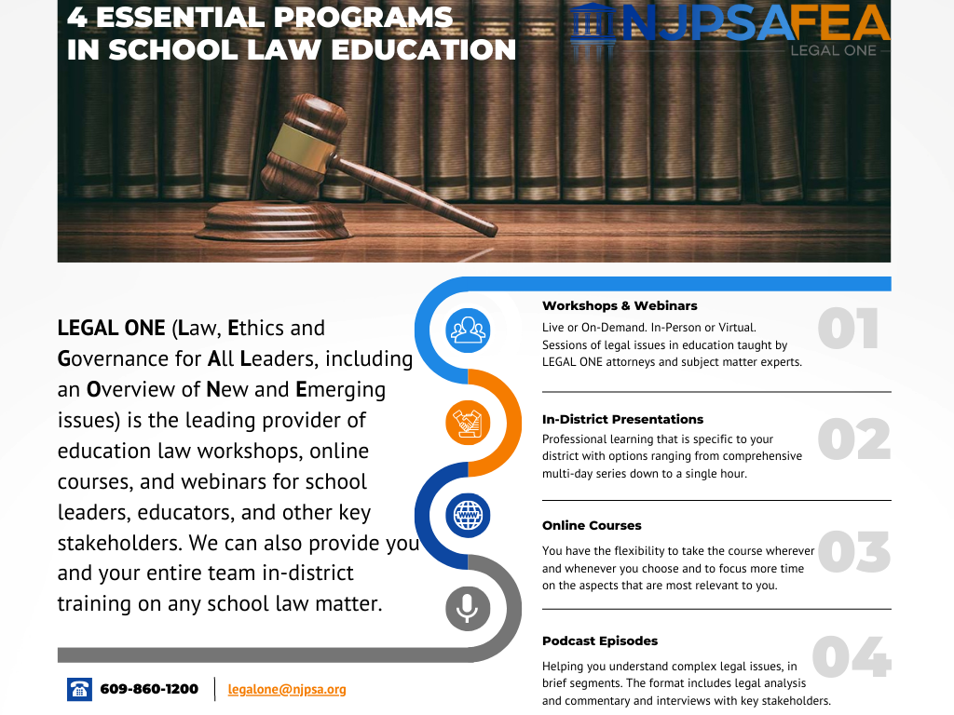

Slide 86








About the LEGAL ONE PODCAST
As the leading provider of school law training, the LEGAL ONE team of school law experts is pleased to offer the LEGAL ONE Podcast to help you understand complex legal issues through approximately 30-minute episodes
Available in Apple Podcasts and Spotify
LISTEN NOW

Slide 87







Hot Issues in School Law - Back to School Edition
DATE
WORKSHOP
TUESDAY, AUGUST 26, 2025
What were the most important changes in state and federal law that occurred during the 2023-2024 school year? What must you do to address these changes moving forward? This seminar will address key topics, including: -Understanding the impact of shifting federal priorities on school districts legal obligations- Changes in state law regarding employee due process rights - Changing legal requirements related to diversity, equity and inclusion, student health and safety, and mental health- Understanding and addressing the needs of transgender students- Changing federal law requirements and guidance from the U.S. Department of Education; - The latest state and federal case law regarding HIB, IDEA, Section 504, tenure, discrimination law, First Amendment rights and more; - The latest guidance on educating and working with students with disabilities;- Legal considerations regarding the use of Artificial Intelligence in schools, and- Recent developments regarding employee, student and parent rights.
TIME
9AM TO 3PM
PRESENTERS
SANDRA L. JACQUES, ESQ., LL.M., ASSISTANT DIRECTOR OF LEGAL EDUCATION; JOHN WORTHINGTON, ESQ., COORDINATOR OF SPECIAL EDUCATION LAW
FEE
$150 MEMBERS/NON MEMBERS
LOCATION
FEA CONFERENCE CENTER, 12 CENTRE DRIVE, MONROE TOWNSHIP, NJ 08831
CLICK TO REGISTER
NOTE: All professional development POs are to be issued to FEA and sent to feasupport@njpsa.org; "Member" pricing applies only to active NJPSA members.

Slide 88
Thank You!

